Slide 1



Library Book Management System

Slide 2
Project Description:
The Library Management System is a desktop-based GUI application built using Python and Tkinter. It helps manage a digital catalog of books by supporting operations like adding, removing, issuing, and returning books, along with displaying available and issued books. The system provides a user-friendly interface with scrollable text areas, stylized buttons, status bars, and customizable book data management (manual or auto-generated).
It also keeps track of issued books by storing student names and issue dates. The GUI is visually enhanced with custom fonts, color schemes, and icons for intuitive usage. This project is ideal for small libraries or educational institutions to maintain book records efficiently.

Slide 3
Technologies & Tools Used:
🧰 Technology / Tool | 📝 Purpose
Python 3.x | Core programming language used to build the application logic
Tkinter | GUI library for creating desktop application interface
tkinter.ttk | For enhanced widgets like styled buttons
ScrolledText | To display large outputs in a scrollable text box
tkinter.simpledialog | For taking user input via pop-up dialogs
tkinter.messagebox | To display information, warning, and error messages
random | To auto-generate book entries with random titles/authors
datetime | To store and format book issue dates
tkinter.font.Font | For customizing font styles across the GUI

Slide 4
⚠️ Challenge | 🧩 Description
Data Persistence | The app currently stores data in memory only; restarting the app clears all book and issue records. Persistent storage (e.g., JSON or database) needs integration.
Duplicate Book IDs | Handling and validating duplicate Book IDs in manual entry required custom checks and error handling.
User Input Validation | Managing cancel actions and invalid entries in dialogs (like empty strings or non-integer inputs) required extra exception handling.
GUI Responsiveness | Designing a responsive and neat layout with properly aligned buttons and expandable areas was a UI challenge.
Book Status Management | Keeping track of book availability after issue/return and synchronizing this with the display was tricky at first.
Separation of Concerns | Integrating backend logic (issue/return module) with frontend GUI required clean communication and shared data management.

Slide 5
Project Approach:
The project followed a structured approach starting with planning the key functionalities like adding, removing, issuing, and listing books. The user interface was built using Tkinter, focusing on clean layout, color themes, and usability. Core backend logic was developed using Python lists and dictionaries to manage books and issued records. Manual and auto book entry modes were added with input validation. GUI actions were integrated with backend logic to provide real-time updates and feedback. Extensive testing was performed to handle edge cases such as duplicate entries, unavailable books, and invalid inputs. The final application is modular, interactive, and easy to use.

Slide 6
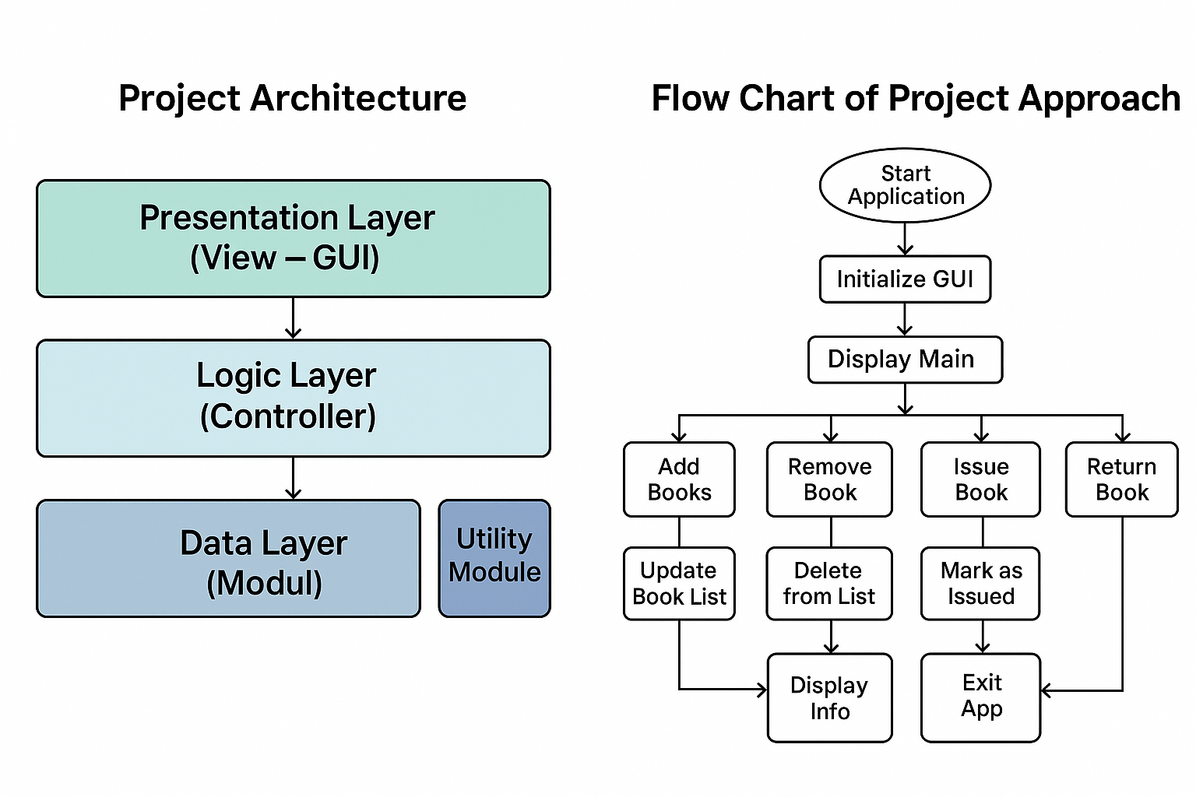

Slide 7
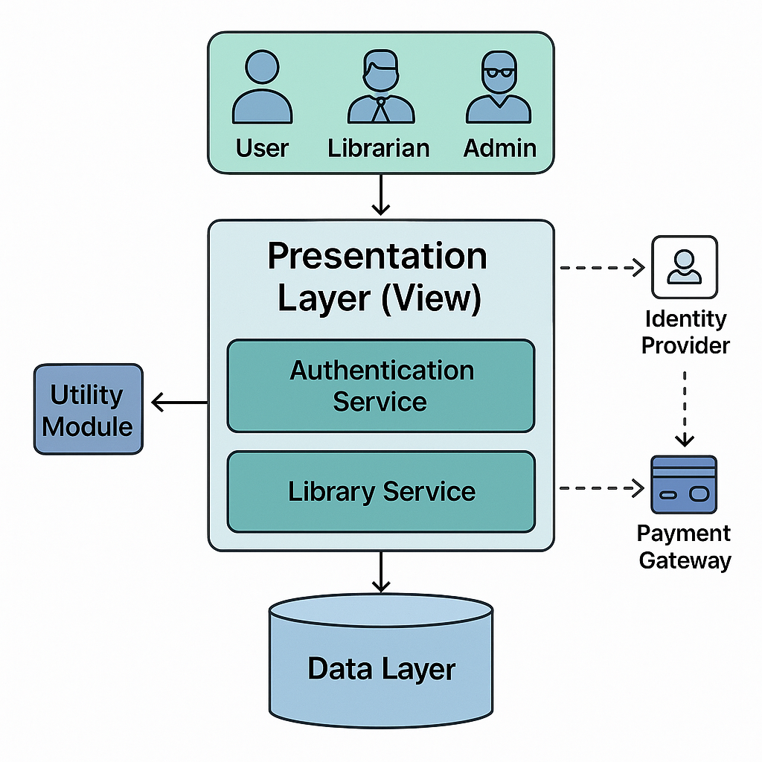

Slide 8
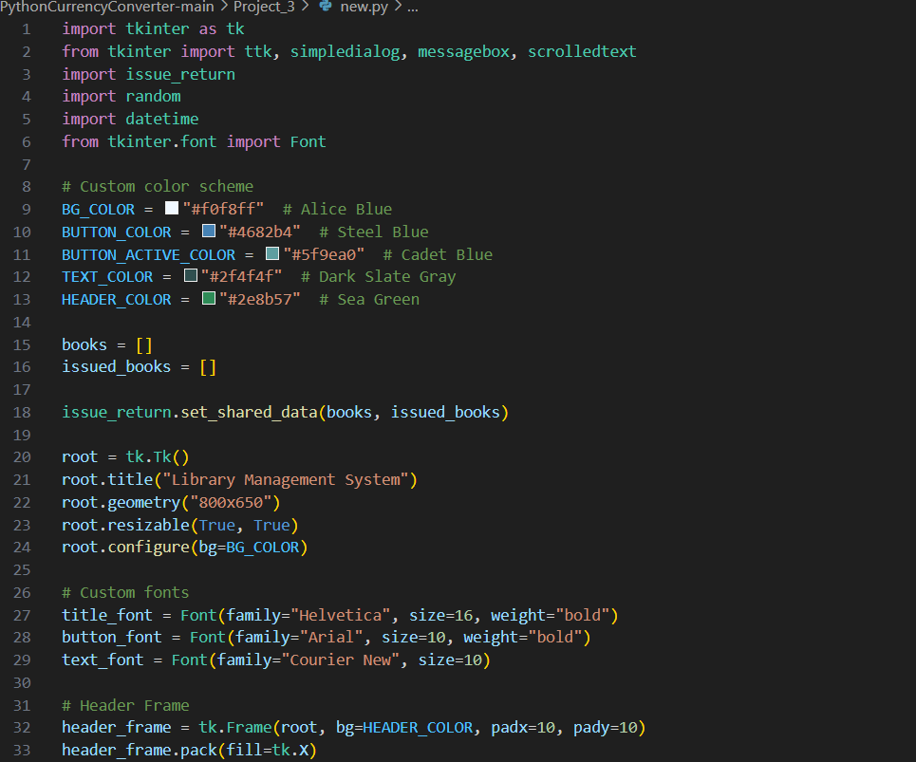
CODES

Slide 9
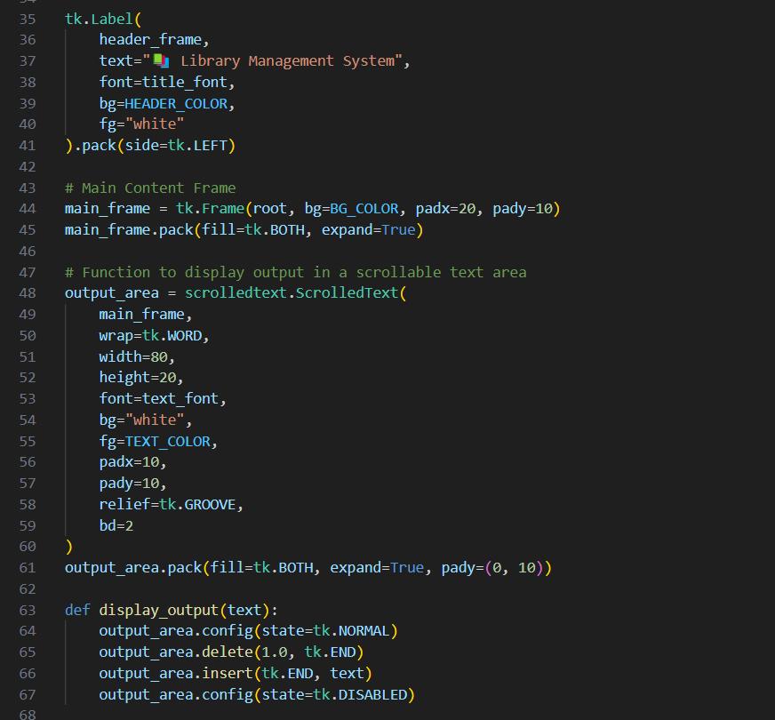

Slide 10
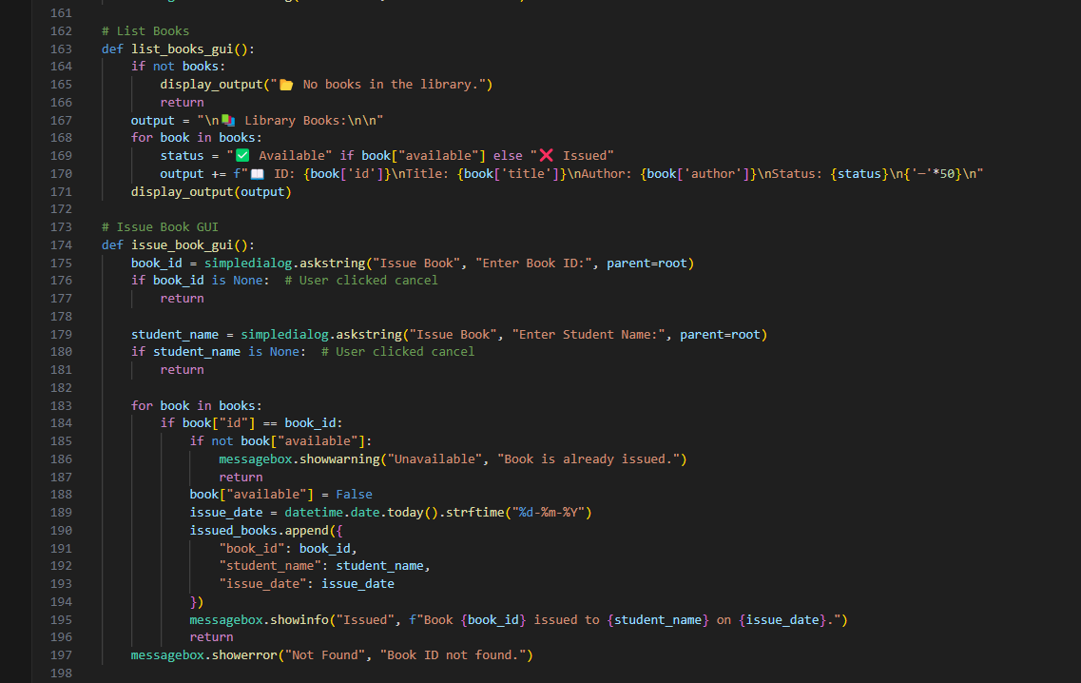

Slide 11
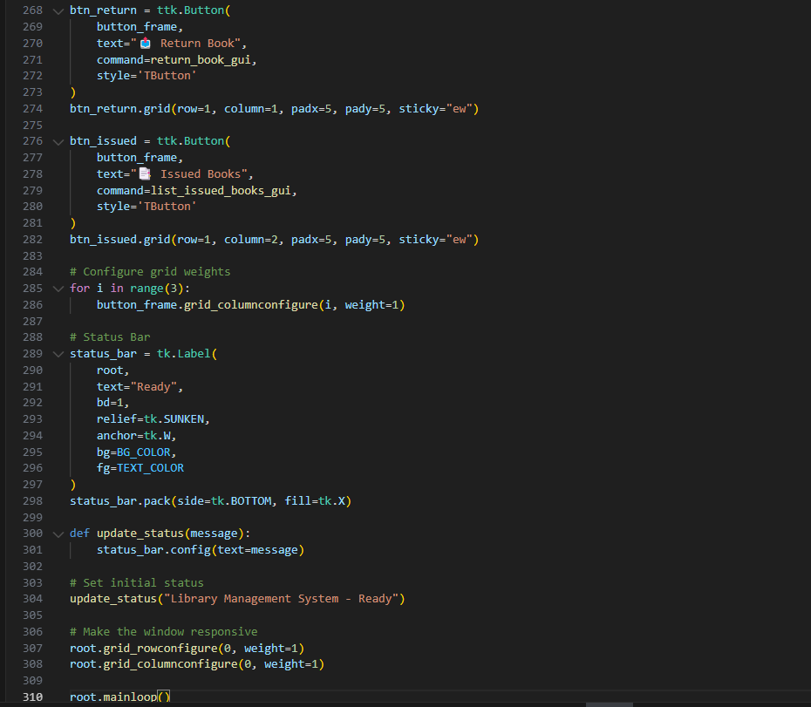
CODES

Slide 12

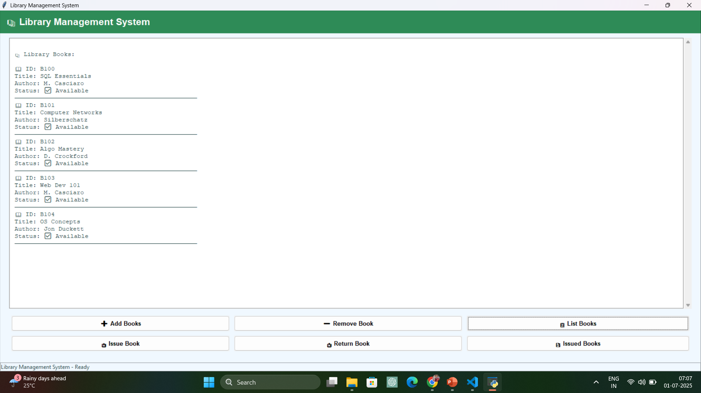
OUTPUT

Slide 13
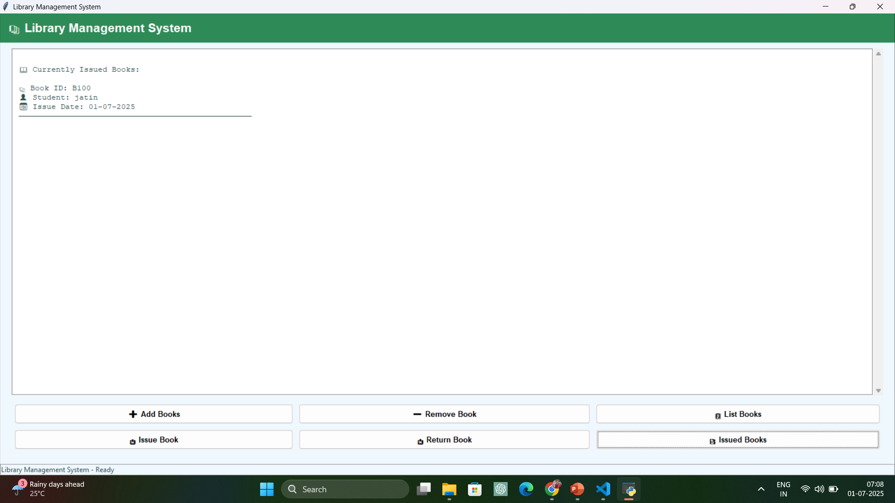

Slide 14
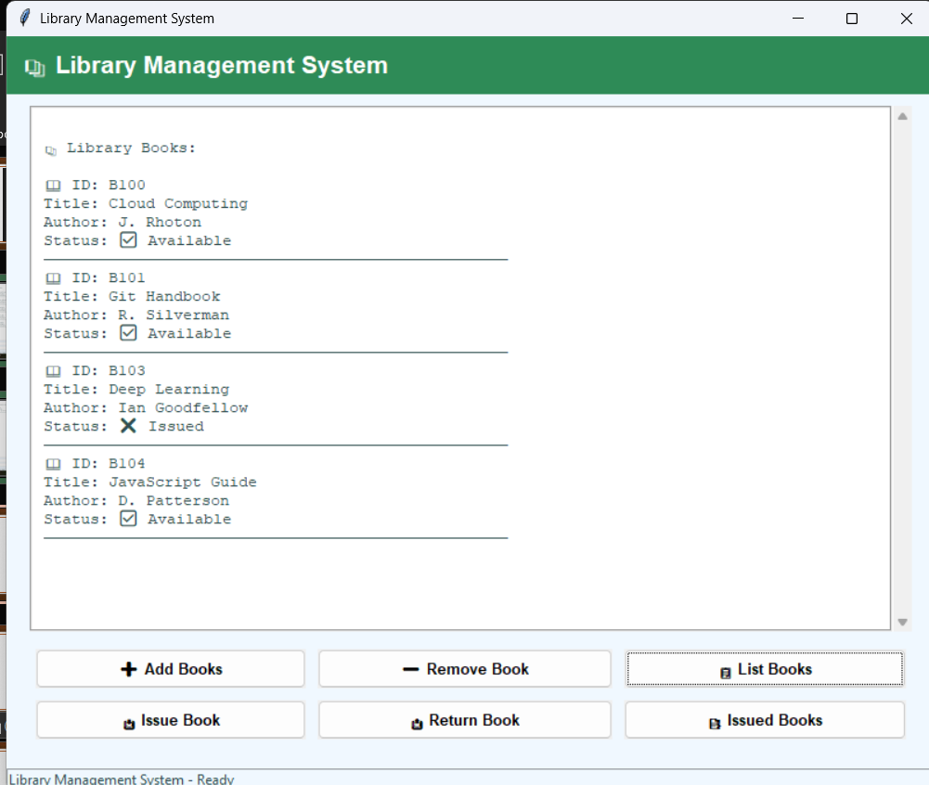
FINAL OUTPUT

Slide 15

Library Book Management System
SUBMITTED TO TAMIZHAN SKILLS
SUBMITTED BY: JATIN KUMAR

